Slide 1
An Multi Collaborative Agents in E-Commerce System
UNDER THE GUIDANCE OF
M.TRINATHBASU
Batch No:239
By:
B.Ratnaji-170030165
SK.JAMSHEER ASLAM-170031189
G.SAI RANI-170031506
Y.MADHURI SRI-17003159

Slide 2
ABSTRACT
An E-Commerce based system is developed using many cooperative systems such as core business system, Payment Systems and a Logistics system. These systems must collaborative to provide overall functionality of the entire system.
There shall be software component in each of the system so as to facilitate communication for collocating and cooperating.
The collaborative agents needs to be intelligent that they behave dynamically as per the changing environment and profiles of the users who will be doing the e-commerce through the user interface provided by the e-commerce portal.
The collaborative agents takes the environmental percepts as inputs, validates the same against the knowledgebase through different search techniques and finds solution models required to process the inputs.
While the interaction takes place among the cooperating agents, each agent will learn other agent and provide input accordingly.

Slide 3
SUBSTRINGS
Collaborative Agents
Machine Learning Collaborative Agents
Modelling Collaborative Agents
Collaborative Agent based Applications
Collaborative Agents Frameworks
6. Intelligent Collaborative Agents

Slide 4
Environment Requirement
You need to be having Microsoft WebMatrix or Visual Studio where you can build, compile and run this project. For beginners you can download Microsoft WebMatrix from the Microsoft's website (http://www.microsoft.com/web) and then run this project. When you download the software, Web Platform Installer would install all the required software for the project to run.

Slide 5
Introduction
An E-Commerce based system is developed using many cooperative systems such as core business system, Payment Systems and a Logistics system. These systems must collaborative to provide overall functionality of the entire system.
There shall be software component in each of the system so as to facilitate communication for collocating and cooperating.

Slide 6
What is E-Commerce?
An E-Commerce based system is developed using many cooperative systems such as core business system, Payment Systems and a Logistics system. These systems must collaborative to provide overall functionality of the entire system.
E-commerce business may employ some of all the following:
Online shopping websites for retail sales direct to consumers.
Business-to-business buying and selling.
Gathering and using demographic data through web contacts and social medias.
Business-to-business data electronic change .
Engaging in pretail for launching new products and services.

Slide 7
Major points/Requirements
A platform where the a user can view all the content of the website. Like the items to display in the web page.
This project also requires a Database, that must be set up for the process of transaction and user account. Most of the eCommerce professionals build a database and allow the users to set up their account. So that they can have a customer and so on.
Basic implementation of security in your website, to prevent hacking and so on.
Code for each type of item to be handled, and for each user. Guest and registered user must be handled as they deserve to be.
UI must be user friendly and user must feel free to browser your website. Provide him with less but efficient details.

Slide 8
Database Design
Database design is a very basic and most important part in this shopping website. You put all of your content inside of the Database, and then extract it from there.
Designing a database as per your requirement is very essential step. You need to make an algorithm for the tables and the objects inside each table that you would need. For example, in a Product table you need to be having these following objects a lot.
1.ProductId Which is used to distinguish among all the products. This is the ID that you assing to it. Its data type is int, since you would not be using ABC as the ID of the product.
2.ProductName This tells the user what is this product. Most of the products are understandable using their name. "Apple Pie" is a name for the product. It suggests the user what this product is. You can easily understand that this is a pie made up of apples.

Slide 9
3.ProductDescription Sometimes it is easy to fully describe your product and the help or support product would provide the user with. "Apple pie, made out of fresh apples". Nice description though, to explain that this pie is made up of fresh apples.
4.ProductPrice Used to tell the user, how much he would be required to pay for this product. Usually you pass this value in dollars but providing this in user friendly mode (in local currency) is a better attempt.
5.AvailableItems This feature enables the users to know how much quantity of the product is available. This is not required, it is just optional where you can tell the user how much he can buy right now. Most of the major companies use this to tell their customers, where purchase is made in tens and hundreds, that he can right now buy only this much items or he must order for more.

Slide 10
The User table would be only created if you want to allow the users to have accounts on their website. Users table would be like this
UserId Same purpose, just to distinguish between users. There might be another user with the name "Afzaal" but no other user with ID of 1.
Email Used to contact the user to inform the user for his purchase.
Name To identify the user. Although this is not required you can use the email of his, but calling the user as "Hello, Afzaal!" is better than calling him as "Hello, example@example.com".
...add more functions to this table if you need so.

Slide 11
Then comes the final table required, the purchases that are made through your website. You need to save these purchases, so that if any error occurs in transaction or the deal doesn't reach the destination you can track it in your website and guide the customer. It is as
UserId The user id of the user that made the purchase
ProductId The id of the product that was purched
Time Time of the purchase

Slide 12
Then comes the final table required, the purchases that are made through your website. You need to save these purchases, so that if any error occurs in transaction or the deal doesn't reach the destination you can track it in your website and guide the customer. It is as
UserId The user id of the user that made the purchase
ProductId The id of the product that was purched
Time Time of the purchase

Slide 13
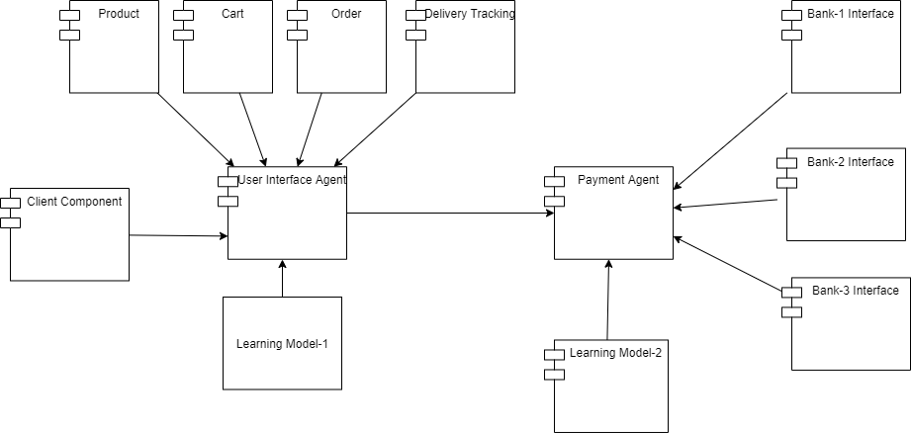
ARCHITECTURE DESIGN

Slide 14
conclusion
The Ecommerce Application shall be developed using two servers and a Client using Microsoft Technologies. The client will be Browser based.
On the 1st Server five components will be developed which include a user interface component which is agent based component that interacts with five other components that include product, cart, order, and delivery tracking components. User interface agent component is intelligent that it learns the behaviour of the user maintains the user histories and provides the comparative picture of the produces that the user generally purchase.
In the second server a payment agent related component will be a resident which interacts with many other banking system resident components. The Payment component is intelligent that keeps track of financial history of the User through adaption of a learning model.
Both the agents will be collaborating with each other by exchanging purchase history and the payment history so that quick actions are taken to facilitate effective and efficient ecommerce system.

Slide 15
DEVELOPMENT AND IMPLEMENTATION PLATFORM
Entire Application will be developed using Eclipse or NETbeans platform and the same will be hosted on a private WEB and the working of the system will be demonstrated.
Research will be carried to determine two learning models for User Interface agent, and the Payment agent and the findings will be published.

Slide 16
References
Chen,J 2014, Pricing Stratigies in the Electronic Marketplace, in: Martinez-lopez 2014,pp.489-522.
Chuan, P & Khchidze, V & Lai, IKW & Liu(ed.) 2013, Innovation in the High-Tec Economy ,Springer-Velag Heidelberg New york Dordrecht London, IBSN (ebook).
Online websites etc
https://www.codeproject.com/Articles/805726/Creating-a-shop-website-in-ASP-NET

